Slide 1
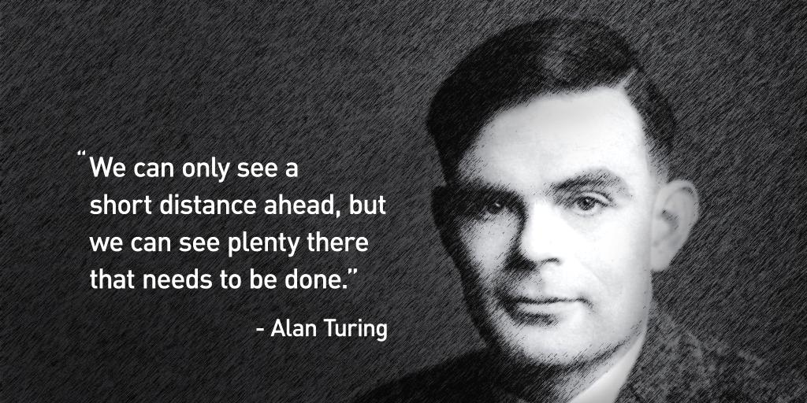
Alan Turing
By: Abigail Appiagyei

Slide 2
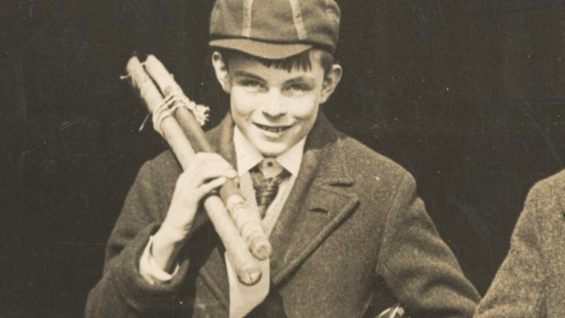
Who is Alan Turing
Alan Turing was born on June 23, 1912 in Maida Vale
English Mathematician and computer scientist
He is generally Known for helping decode germany's Enigma code

Slide 3
Alan Turing main contribution to world war II was he made a code-breaking machine called the bombe which later on was supplied to military allies
The main contribution to computer science was the Automatic Computing Engine (ACE) was the first complete specification of an electronic stored-program all-purpose digital computer

Slide 4
WWII
The Germany military used the device to send strategic messages before and after the war
Alan was able decipher the code using complex patterns

Slide 5
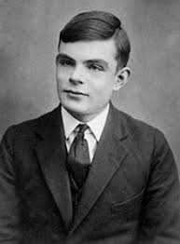
What he Accomplished
He was able to break the enigma code
He created a code-breaking machine which got used in the war

Slide 6
Later Life
He kept his homosexuality a secret so no really knew he was gay
Since homosexuality was a crime back in the early 1900’s he had a criminal record and
couldn’t work at the British government’s postwar code-breaking center
Alan Turing was discovered dead in his bed poisoned by cyanide

Slide 7
Thank You

